Slide 1
Interim project presentation SLAQ : Quality-Driven Scheduling for Distributed Machine Learning
COS 518: Advanced Computer Systems
Allen Welkie, David Liu, Minsung Kim

Slide 2
Problem Overview
Machine Learning (ML) model complexity and data volume is growing extremely fast.
ML typically requires many iterations for training and training stage is computationally expensive.
Hardware speed improvements are relatively slow.
The quality improvement diminishes as more iterations are completed.
Existing schedulers for large-scale training jobs in clusters with shared resource primarily focus on resource fairness.
This is not efficient!

Slide 3
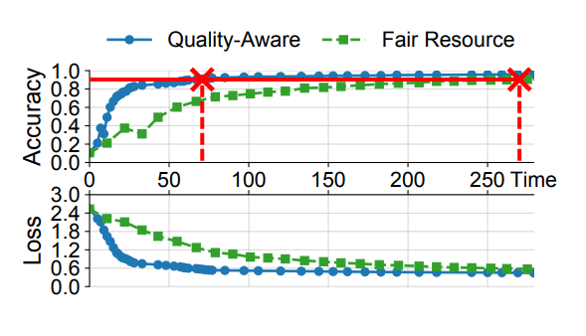
Technical Solutions
SLAQ is a cluster scheduler for ML training jobs that aims to maximize the overall job quality improvement.
Dynamically allocates more resources to the jobs that have the most potential quality improvement based on job resource demands, intermediate model quality, and the system’s workload.
Notes:
SLAQ is a cluster scheduler for ML training workloads on data analytics platforms. Specifically, SLAQ is designed to work with distributed ML training jobs on batch-processing frameworks (e.g., Spark and MapReduce).
SLAQ leverages ML job characteristics, specifically its iterative and approximate nature. When assigning resources to distributed large-scale machine learning, many iterations are typically required to improve the quality of the model. SLAQ re-allocates cluster resources at the end of an iteration to jobs that have the greatest potential quality improvement. The potential improvement is estimated based on the convergent behavior of training loss function. As more iterations are processed, the loss function (model quality) converges to a final value. Therefore later iterations usually delivers smaller improvement.
Jobs in early stage could benefit a lot from additional resources
Jobs almost converged make only marginal improvement

Slide 4
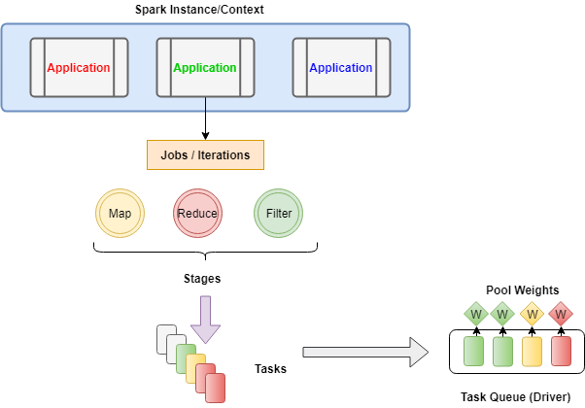
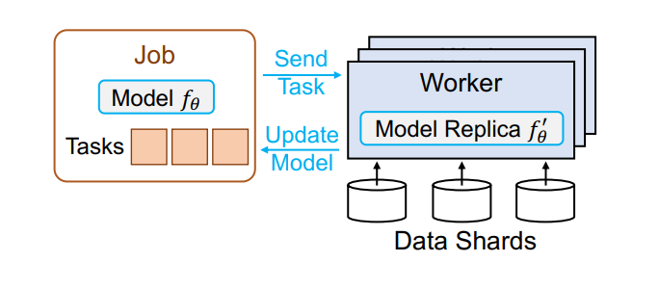
Implementation Plan
Will reproduce the improvements to performance that the authors saw between the fair scheduler and SLAQ
Will implement SLAQ on Spark scheduler

Slide 5
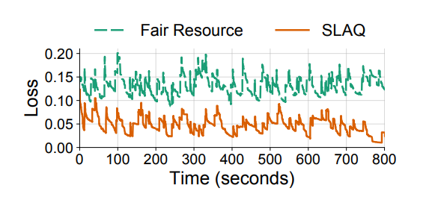
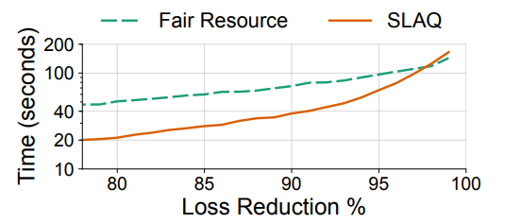
Evaluation Plan
Will train the same models that the original authors trained using Spark MLlib
Baseline Comparison (evaluation) : Fair scheduler
Expected Results :
Quality : SLAQ’s average loss is 73% lower than that of the fair scheduler
Time : SLAQ reduces time to reach 90% loss reduction by 45%

